Slide 1




ASP .NET MVC 5
Nemanja Kojic, MScEE
1

Slide 2
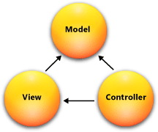
What is MVC?
Model-View-Controller (MVC)
Standard Architectural Pattern
Separation of concerns: model, view, controller
10 of 114

Slide 3
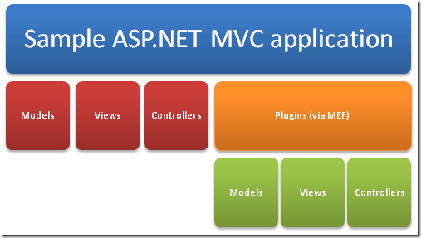
ASP .NET MVC Framework
An alternative to ASP .NET Web Forms
Presentation framework
Lightweight
Highly testable
Integrated with the existing ASP .NET features:
Master pages
Membership-Based
Authentication
...
10 of 114

Slide 4
ASP .NET MVC Framework Components
Models
Business/domain logic
Model objects, retrieve and store model state in a persistent storage (database).
Views
Display application’s UI
UI created from the model data
Controllers
Handle user input and interaction
Work with model
Select a view for rendering UI
10 of 114

Slide 5
When to use MVC approach?
Advantages:
Easier to manage complexity (divide and conquer)
It does not use server forms and view state
Front Controller pattern (rich routing)
Better support for test-driven development
Ideal for distributed and large teams
High degree of control over the application behavior
10 of 114

Slide 6
ASP .NET MVC Features
Separation of application tasks
Input logic, business logic, UI logic
Support for test-driven development
Unit testing
No need to start app server
Extensible and pluggable framework
Components easily replaceable or customized (view engine, URL routing, data serialization,…)
10 of 114

Slide 7
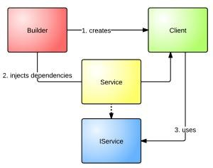
ASP .NET MVC Features (cont.)
Support for Dependency Injection (DI)
Injecting objects into a class
Class doesn’t need to create objects itself
Support for Inversion of Control (IOC)
If an object requires another object, the first should get the second from an outside source (configuration file)
10 of 114

Slide 8
ASP .NET MVC Features (cont.)
Extensive support for ASP .NET routing
Building apps with comprehensible and searchable URLs
Customizable URLs
Adapted to work well with search engines
Adapted to REST addressing
Decoupled from resource files
Use of existing ASP .NET features (backward compatibility)
10 of 114

Slide 9
ASP .NET MVC App Structure
URLs mapped to controller classes
Controller
handles requests,
executes appropriate logic and
calls a View to generate HTML response
URL routing
ASP .NET routing engine (flexible mapping)
Support for defining customized routing rules
Automatic passing/parsing of parameters
10 of 114

Slide 10
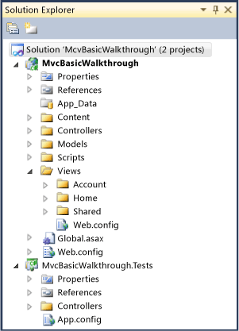
ASP .NET App Structure
No Postback interaction!
All user interactions routed to a controller
No view state and page lifecycle events
10 of 114

Slide 11
MVC App Execution
Entry points to MVC:
UrlRoutingModule and MvcRouteHandler
Request handling:
Select appropriate controller
Obtain a specific controller instance
Call the controller’s Execute method
10 of 114

Slide 12
MVC App Execution - stages
Receive first request for the application
Populating RouteTable
Perform routing
Create MVC Request handler
Create controller
Execute controller
Invoke action
Execute result
ViewResult, RedirectToRouteResult, ContentResult, FileResult, JsonResult, RedirectResult
10 of 114

Slide 13
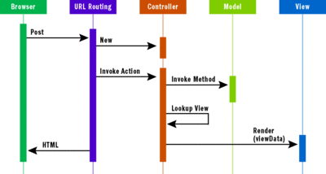
MVC App Execution
10 of 114

Slide 14
BUILDING VIEW PAGES USING RAZOR LANGUAGE
RAZOR ENGINE
10 of 114

Slide 15
Razor Engine
A new view-engine
Optimized around HTML generation
Code-focused templating approach
10 of 114

Slide 16
Razor Engine – Design goals
Compact, Expressive and Fluid
Easy to learn
It is not a new language
Works with any text editor
Great Intellisense
Unit-testable
– Testing views without server, controllers…
10 of 114

Slide 17



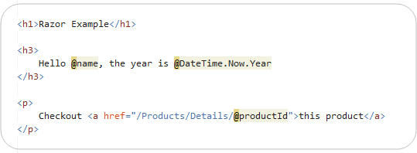
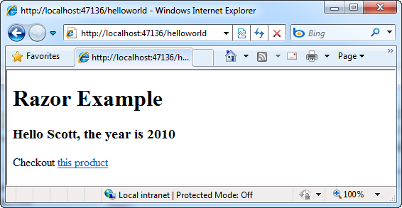

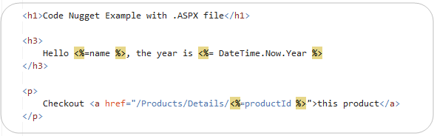


Razor – HelloWorld
Uses @ for Razor blocks
razor file
.aspx file
10 of 114

Slide 18






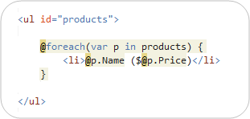
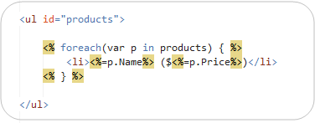
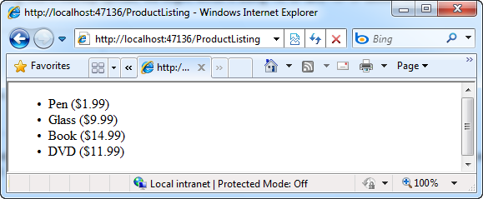
Loops and Nested HTML
Razor syntax .aspx syntax
10 of 114

Slide 19






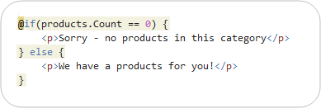





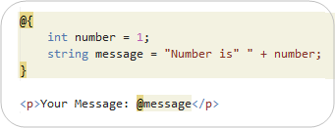
If Blocks and Multi-line Statements
Multi-Token statement
IF statement
Multi-line statement
Variables can span ^{Variab}m^{le}u^{s}ltiple server
code blocks!
10 of 114

Slide 20



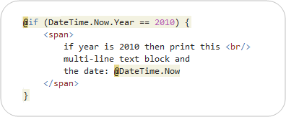



Integrating Content and Code
Parser examines right-hand side of @ character.
Identifying nested content with HTML block tag
10 of 114

Slide 21
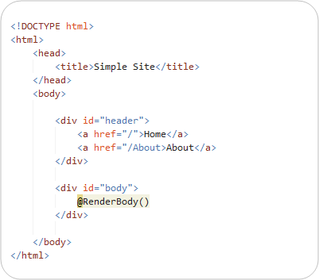





Layout/Master page
SiteLayout.cshtml
@RenderBody() Including specific body content.
10 of 114

Slide 22
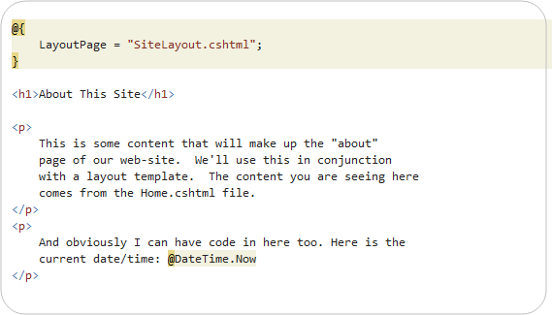


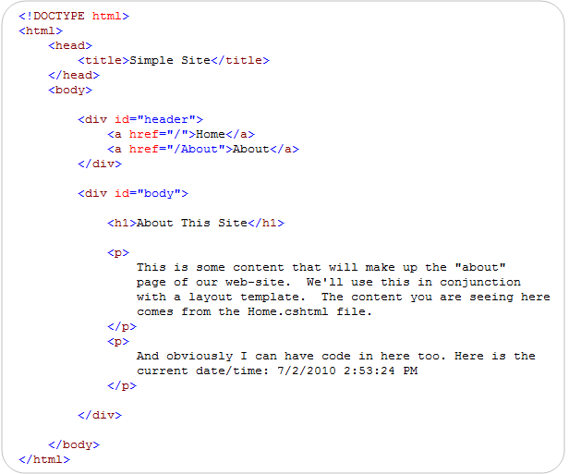



Content page
Explicitly setting LayoutPage property.
Complete HTML page.
10 of 114

Slide 23
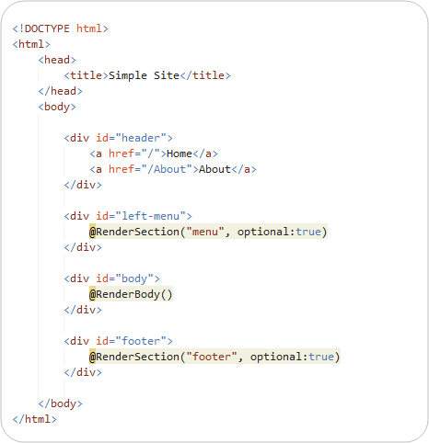



Master page – section overrides
This section is optional.
This section is optional.
10 of 114

Slide 24
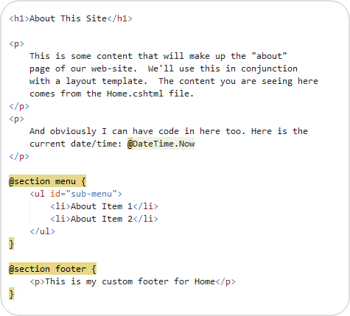





Master page – section overrides
Named section.
Named section.
10 of 114

Slide 25
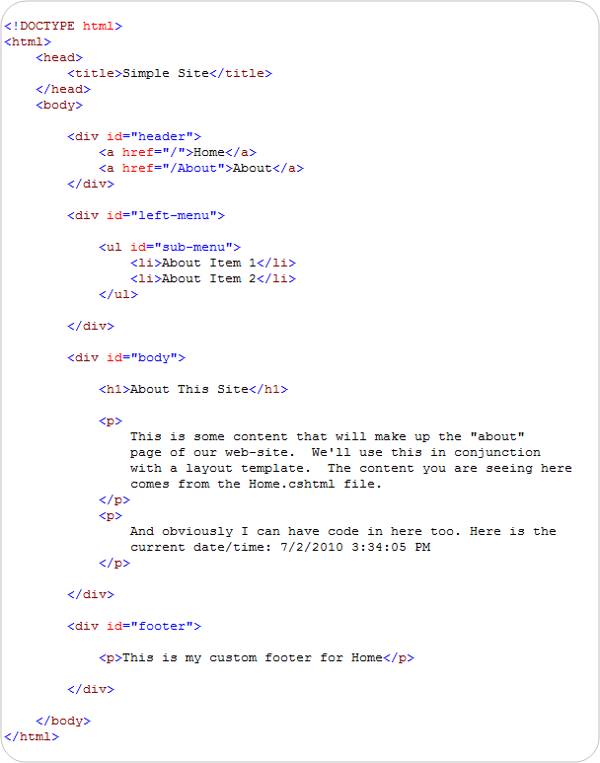
Master page – result html
10 of 114

Slide 26
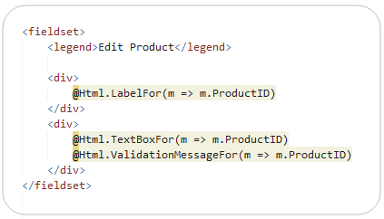



Re-usable “HTML Helpers”
Methods that can be invoked within code-blocks
Encapsulate generating HTML
Implemented using pure code
Work with Razor engine
Built-in HTML helper
10 of 114

Slide 27






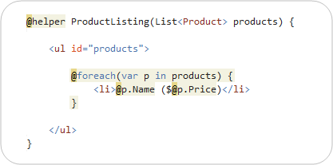






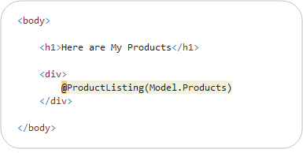



Define own HTML helpers
@helper declarative syntax
Helper’s parameters (full language and ebugging support)
HTML Helper definition
HTML Helper should be placed to Views\Helper directory.
HTML Helper Invocation
10 of 114

Slide 28
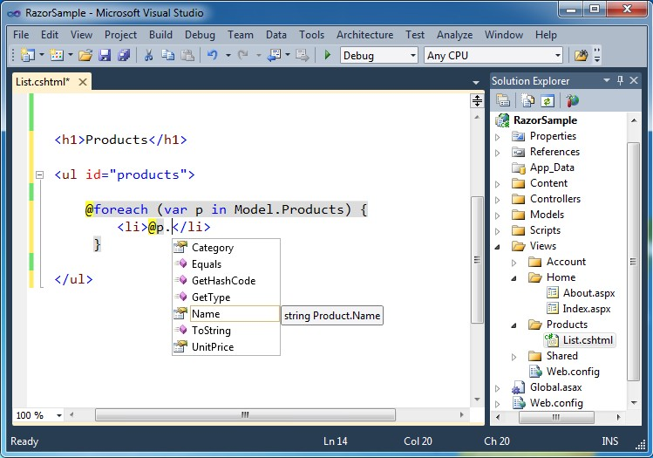
Visual Studio support
10 of 114

Slide 29
Razor – Summary
A good new view engine
Code-focused templating
Fast and expressive
Compact syntax
Integrated with C# and VB
10 of 114

Slide 30
CREATING ASP .NET MVC APPLICATION
10 of 114

Slide 31
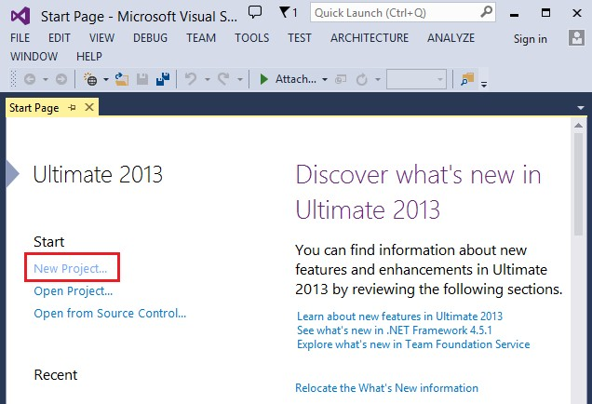
New Project …
31

Slide 32
32 of 114

Slide 33
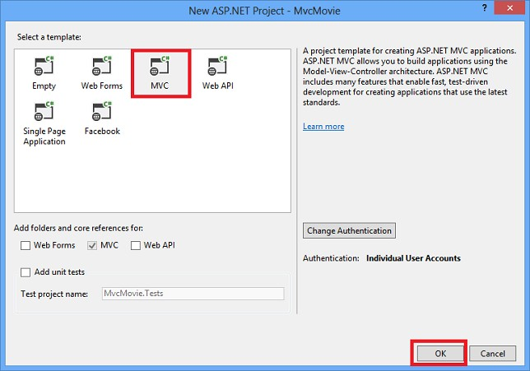
Select the project template
33

Slide 34
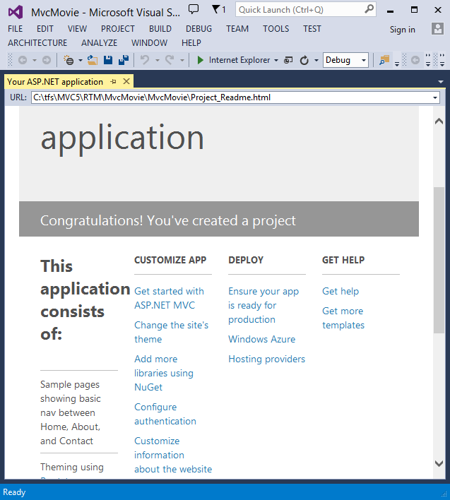
ASP .NET MVC App Home page
33

Slide 35
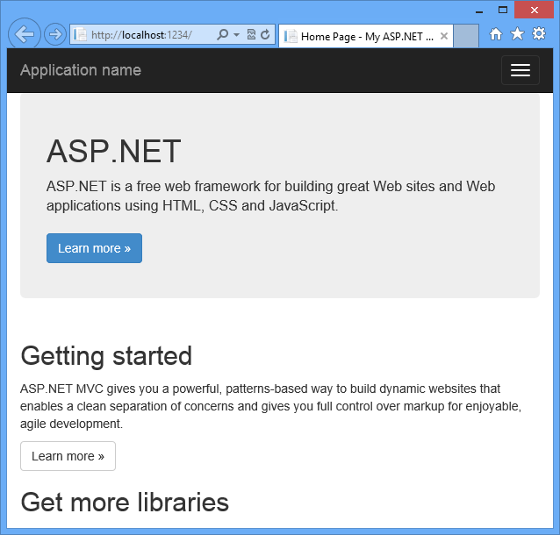
Run the application…
33

Slide 36
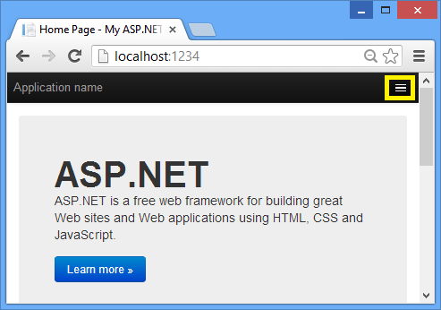
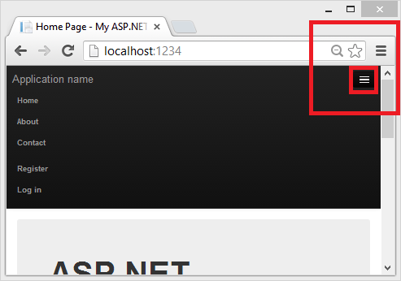
Expand the default App menu
33

Slide 37
ADDING CONTROLLER
37 of 114

Slide 38
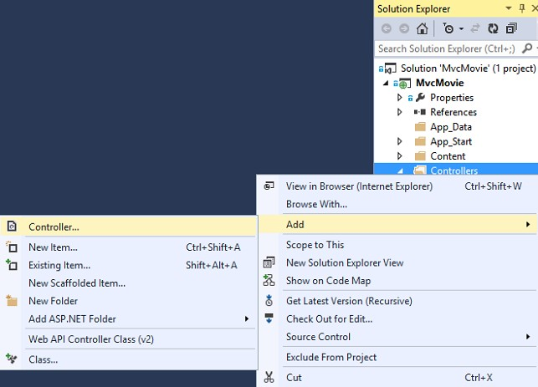
Adding controller
38

Slide 39
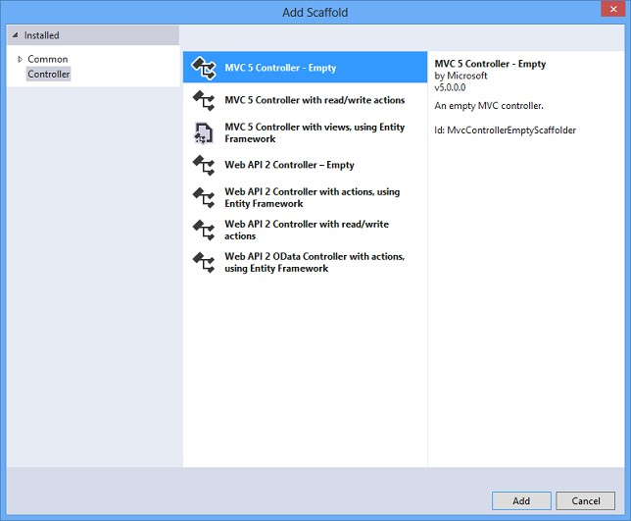
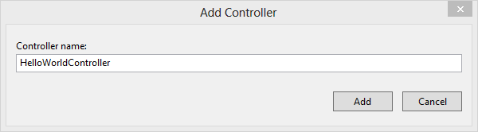
Adding controller (cont.)
38

Slide 40
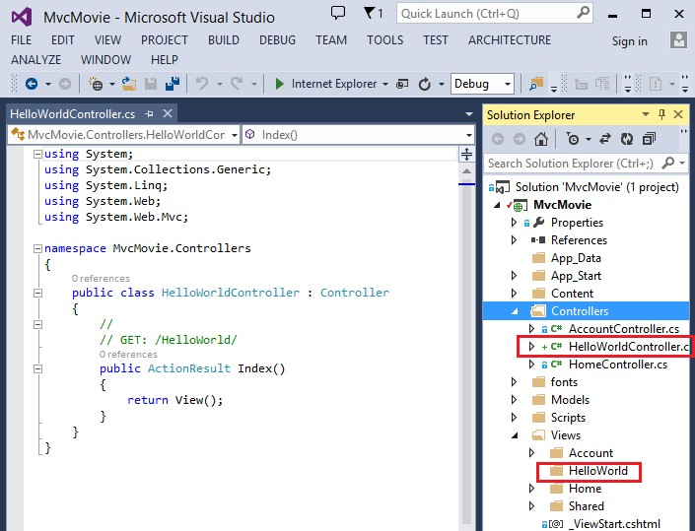
Adding a controller (cont.)
38

Slide 41
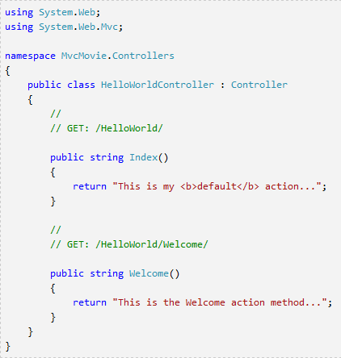
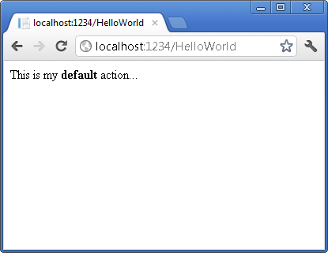
Testing the controller
38

Slide 42
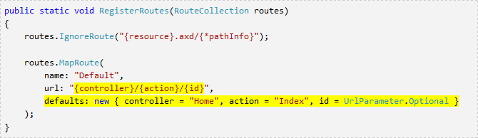
Mapping controller
Controller selection based on URL
Default URL routing logic:
/[Controller]/[ActionName]/[Parameters]
Format for routing in
App_Start/RouteConfig.cs
42 of 114

Slide 43
URL routing
Webapp URL without URL segments => HomeController::Index()
Index() – default method of a controller
/HelloWorld => HelloWorldController
/HelloWorld/Index => HelloWorldController::Index()
http://webapp:port/HelloWorld/Welcome => HelloWorldController::Welcome()
42 of 114

Slide 44

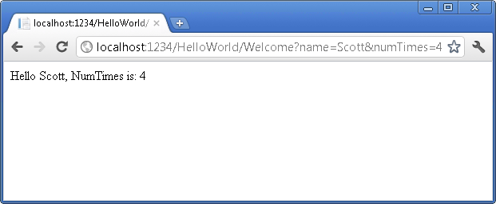
Parameters
/HelloWorld/Welcome?name=Scott&numtimes=4
Introducing 2 parameters to Welcome method
Parameters passed as query strings!
42 of 114

Slide 45


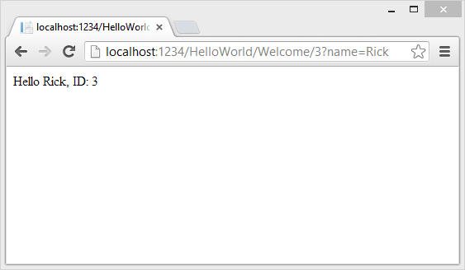


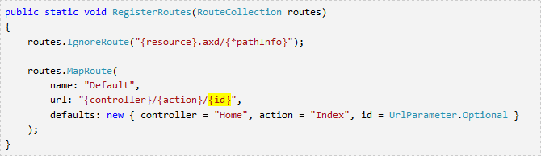
URL Parameters
http://webapp/HelloWorld/Welcome/3?name=Rick
Parameter ID matches URL specification in RegisterRoutes method.
42 of 114

Slide 46
ADDING A VIEW
42 of 114

Slide 47

Views
Views created using Razor view engine
Controller method returns View object
Controller method return type is ActionResult
Common pattern: all view pages share the same master layout page
42 of 114

Slide 48
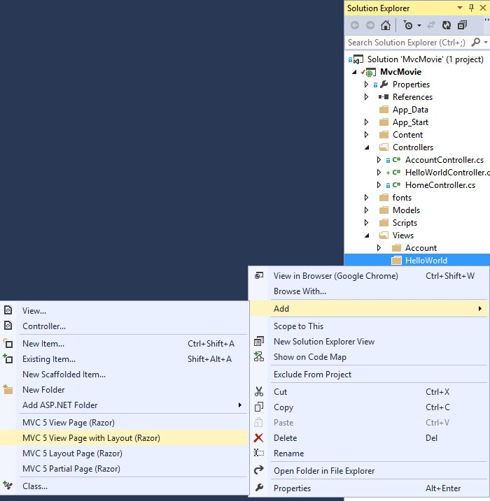
Create View page
42 of 114

Slide 49
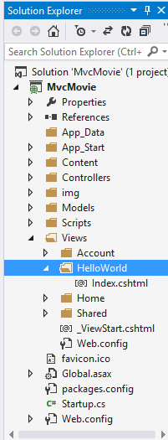
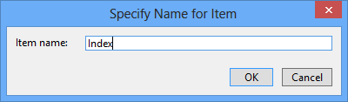
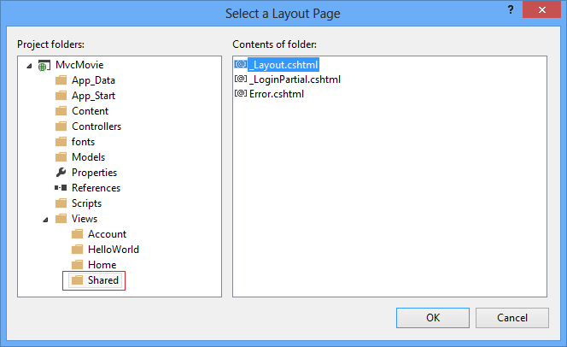





Create View page
Master page.
42 of 114

Slide 50
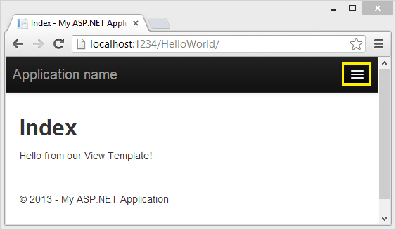






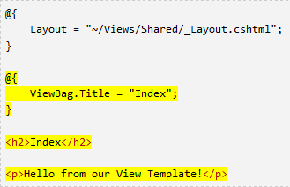




Implementing View page
Selected master page.
Index, by default.
Change controller’s method signature.
The method retures a view object: searches a view file that is named the same as the method (Index.cshtml).
50 of 114

Slide 51



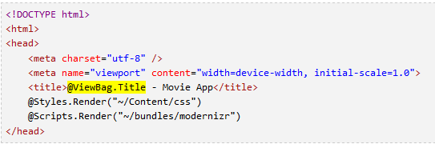



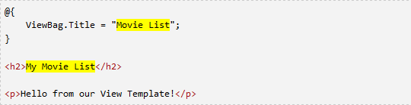
ViewBag
Pass data between view template and layout view file
ViewBag is a dynamic object (has no defined properties)
View template file.
Layout view file.

Slide 52
Passing data from Controller to View
View is used for data presentation
Controller must provide a view with the data
One approach: using ViewBag
Controller puts data to ViewBag,
View reads ViewBag and renders the data
No data binding!
Alternative approach: the view model
Strongly typed approach

Slide 53






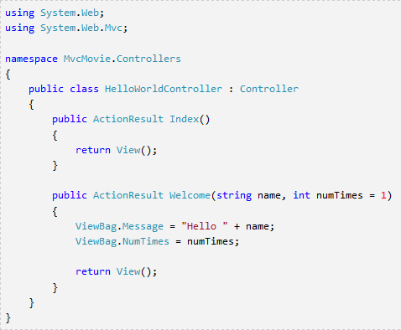
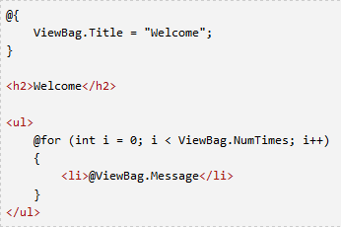




Passing data from Controller to View
Controller
View
Returns HelloWorldView object.

Slide 54
ADDING A MODEL

Slide 55
Model components
Entity framework - data access technology
“Code first” development paradigm
(first code classes, then generate DB schema)
“Database first” development paradigm define db schema first,
then generate models, controllers and views

Slide 56




Adding a model class
Enter the class name,
e.g. Movie.cs

Slide 57

Adding properties to a model class

Slide 58







Adding a DbContext class
EF namespace DbContext DbSet
EF database context FETCH, INSERT, UPDATE

Slide 59






DB Connection string
Separate connection string for each DbContex class

Slide 60

Accessing Model from a Controller

Slide 61







Accessing Model from a Controller
Visual Studio Creates:
A controller MoviesController.cs file in Controllers folder, Create.cshtml, Delete.cshtml, Details.cshtml, Index.cshtml in Views\Movies folder.
Strongly typed
approach.

Slide 62











Run Application…
Notice: default routing
Creates a new movie.
Database is still empty.
Notice: generic column name, derived from the model class.

Slide 63







Creating a model object
Automatically generated form, based on the model info.

Slide 64







Generated Controller class
Instantiated DbContext instance.
Index method.

Slide 65
Strongly typed models
MVC provides strongly typed way of passing data from Controller to View
Better compile-time checking
Richer IntelliSense in VS code editor

Slide 66













Strongly typed models
@model: Specifies class of the model
Communicates with the master page.
Id parameter generally passed as a part of the route.
Context-sensitive
data access.

Slide 67











Strongly typed models (cont.)
Index.cshtml
Model object is strongly typed.
Each item is a Movie object.
Full compile-time support.

Slide 68







Edit View
Localhost:1234/movies/Edit/4
URL generated using Html Helpers!

Slide 69










Edit View (cont.)
Parameter passed through the URL query.
Works for MVC default URL mapping.
Label defined in the model class.
Date format defined in the model class.

Slide 70













Edit View
Generates hidden anti-forgery token.
Generates html label.
Generates text box.
Generates validation message.

Slide 71







Property annotations
Annotations namespace.
Overrides default label name on the view page.
Specifies type of the data: displays only date part.
Workaround for a bug in Chrome
☺

Slide 72







ActionLink helper
Html.ActionLink – generates a link according to
a given URL mapping policy
Primer:
Anonymous object – specifies ID of an object
Html.ActionLink(“Edit", “Edit", new{id=item.ID)}
Controller action name.

Slide 73















Edit actions
Implemented as Controller’s operations
HTTP GET operation HTTP POST operation
Prevents request forgery
[Bind] attribute – a security mechanism that prevents over-posting data to the model.
[HttpGet] annotation by default.

Slide 74















Processing the POST request
HTTP POST method. Validates the forgery token.
Checks if sent data are valid – server side validation, compared to client-side validation (javascript)
Redirects after successful update.
In case of invalid data, the original form is returned
back to the client, displaying error messages

Slide 75
HTTP methods – best practices
HttpGet and HttpPost method overloads
All methods that modify data SHOULD use HttpPost method overload
Modifying data in HttpGet method
security risk
Violates HTTP best practices
Violates REST architectural pattern
GET method SHOULD NOT have any side effect and SHOULD NOT modify persistent data

Slide 76
ADDING SEARCH

Slide 77




Search form – Index.cshtml
Enter a text filtering value.

Slide 78





















View/Controller – changes
Controller – changed signature of
View (changes)
the method Index.
LINQ query definition (NOT execution!)
Default form
method = POST!
Lambda expression
Use overriden BeginForm method to force HttpGet method.

Slide 79







Searching movies – URL query
HTTP POST
HTTP GET

Slide 80




Adding search by Genre
HttpGet method handles the request.

Slide 81










Search by Genre – View
Preselected value.
DropDown list markup.
Parameter “movieGenre” is the key for populating dropdown list from ViewBag.

Slide 82







Search by Genre – Controller
Populating the list of genres in ViewBag.
Key movieGenre is the same as the parameter of the dropdown list.

Slide 83

Details method - Controller

Slide 84














Delete method - Controller
HttpGet method.
Selects an objects and returns Details page.
Asp .net maps a segment of URL to a method.
Attribute ActionName is necessary to provide valid URL routing.
The same URL maps to different action methods, based on used HTTP method.
RULE:
Never use a HttpGet method
to modify the model. Opens security holes, architecturally bad!
HttpPost method. Deletes an object having the given id.

Slide 85
Data Validation
Keep Things DRY (Don’t Repeat Yourself)
Declarative validation rules in one place (Model class)
Regular expressions
Range validation
Length validation
NULL values validation
Data formatting
Validation rules enforced before saving changes to the database!

Slide 86





Validation rules – Model
Several validation rules failed.

Slide 87










Data Validation - View
Client-side validation: javascript (jQuery).
Validation rules picked up from the
model class annotations.
Validation messages derived from the validation constraints in the model class.

Slide 88




Data Validation – View (cont.)
Validation message derived from the validation constraints specified for the given Property (Title)

Slide 89





Data Validation - Controller
HttpGet method displays initial Create form.
HttpPost method that does create a new object.
Server-side data validation check.

Slide 90
DataType attributes
Provide only hits for the view engine to format the data
Date, Time, PhoneNumber, EmailAddress,…
Automatic provision of type specific features
e.g. “mailto: ...” link for EmailAddress
Do NOT provide any Validation (just presentation hints)

Slide 91




DisplayFormat annotation
Used to explicitly specify format of the data
Example: redefining the default date format
It is possible to specify validation
properties in one line!

Slide 92

LAMBDA EXPRESSIONS

Slide 93
Introduction
Expressions that use special syntax
Anonymous functions used as data (variables, fields, parameters, return values)
The anonymous functions are used to create delegates and expression trees
Lambda expressions particularly helpful for writing LINQ queries
Available from .NET 4.5

Slide 94
Operator =>
Interpreted as “goes to”
Used for declaring a lambda expression
The same priority as assignment (=)
Right associative operator
Separates the parameters and function body
Left side
=>
Right side
An Empty parameter list A formal parameter list An implicit parameter list
An expression
A Statement list inside curly brackects.

Slide 95
Anonymous functions
Inline statements or expressions
Used wherever a delegate type is expected
It can initialize a named delegete
It can be passed as the parameter where a named delegate type is expected
Two kinds of anonymous functions
Anonymous methods
Lambda expressions

Slide 96










Evolution of delegates in C#
Named method
Inline code (anonymous method)
Lambda expression

Slide 97


Anonymous method
No name, no overloading
Created using the delegate keyword
It is possible to add multiple statements inside its body

Slide 98
Anonymous method (cont.)
Scope of the parameters is the anonymous method block
No jump from inside an anonymous method block to the outside, and vice versa.
Cannot access ref and out parameters of an outer scope
No unsafe code access inside its block
Not allowed on the left side of the operator
is.

Slide 99
Expression lambdas
Lambda expression with an expression on the right side of the operator =>
Used dominantly in construction of expression trees
(input parameters) => expression
Parentheses optional if lambda has one param.
Input parameters separated by comma

Slide 100
Expression lambdas - examples
(x, y) => x == y
The parameters types inferred by the compiler
(int x, string s) => s.Length > x Specify types of the parameters when the compiler cannot inferre them from the code.
() => SomeMethod()
Zero input parameters specified with empty parentheses.
Note: a method call cannot be evaluated outside the .NET Framework (e.g. SQL Server)

Slide 101

Statement lambdas
(input parameters) => {statement;}
Statements enclosed in braces
The body of a statement lambda can contain multiple statements (in practices, two-three)
Cannot be used to create expression trees

Slide 102





Generic delegates – Func
System.Func<T,TResult>
T – argument type,
TResult – return type (last type parameter)
Useful for encapsulating user-defined expressions that are applied to all elements of
a data set
A generic declaration of the delegate Func.
Example of usage.

Slide 103











Func delegate (cont.)
A lambda expression can be passed where Expression<Func> type is required
– System.Linq.Queryable
Output: 5, 1, 3, 9, 7
Compiler can infere the type of the parameter n.
Output: 5, 4, 1, 3
Output: 5, 4

Slide 104



Type inference in lambdas
Compiler can infer the type of the parameters based on:
Lambda’s body
Parameter’s delegate type
Example:
IEnumerable<Customer> customers=...
Standard query operator.

Slide 105
Lambda expressions – general rules
The lambda must contain the same number of parameters as the delegate type
Each input parameter in the lambda must be implicitly convertible to its corresponding delegate parameter
The return value of the lambda (if any) must be implicitly convertible to the delegate’s return type

Slide 106
Lambda expressions - examples
Func<int,int> f1 = x => x+1;
Func<int,int> f2 = x => {return x+1;}
Func<int,int> f3 = (int x) => x +1;
Func<int,int> f4 = (int x) => {return x+1;}
Func<int,int> f7 = delegate(int x) {return x+1;}
Invocation example: Console.Writeln(f1.Invoke(4));

Slide 107
Lambda expressions - examples
Func<int,int,int> f5= (x,y) => x*y
Invocation: Console.Writeln(f5.Invoke(2,2));
Action f6 = () => Console.Writeline(); Function instance that does not receive any parameter nor returns value.
Invocation: f6.Invoke();
Func<int> f8 = delegate { return 1+1;}
Invocation: Console.Writeln(f8());

Slide 108
Language Integrated Query
LINQ

Slide 109
Content
Undestand what LINQ is?
Learn what problems solves
See what its syntax looks like
Know where LINQ can be used

Slide 110
What is LINQ?
Language INtegrated Query
It is part of programming language syntax
Supported by: C#, VB, Delphi Prism
Used for querying data
Supported the following types of data sources
Relational data
XML data
objects
110 of 114

Slide 111

LINQ Architecture
111 of 114

Slide 112
ADO .NET vs. LINQ
ADO .NET
OO library for relational data access
Mapping from relational to
OO objects needed!
High Impedance Missmatch for mapping data from storage to objects in an application
LINQ
SQL-Like syntax that deals with pure objects
Reduces the Impedance
Missmatch
Makes data querying more efficient
One still must know the
format of the data
112

Slide 113
LINQ Adapters
LINQ to Objects
LINQ to SQL
LINQ to XML
LINQ to Entities
It is possible to create own customized adapter
– E.g. LINQ for Querying Twitter API

Slide 114
References
ASP .NET MVC 5 Tutorial – Official http://www.asp.net/mvc/tutorials/mvc- 5/introduction/getting-started
Lambda expressions http://www.dotnetperls.com/lambda
LINQ
http://code.msdn.microsoft.com/101-LINQ- Samples-3fb9811b

